Slide 1
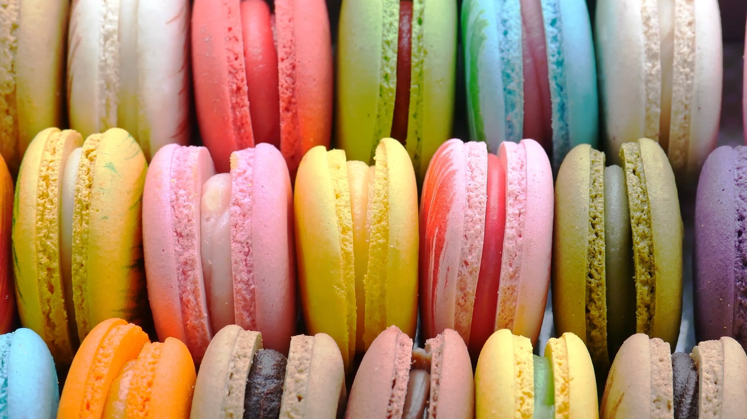
Dessert Palette Adventure
A Delicious Journey into the World of Dessert Recipes
Pei-Ju Wu (Emily)

Slide 2
INTRODUCTION
Project Overview:
We'll explore dessert recipes, uncovering patterns and trends.
Relevance:
Desserts are more than sweet treats; they're edible
art, offering joy, comfort, and kitchen creativity.
Project Goals:
Explore an interactive dessert dashboard .
Ingredients and ratings relationship.
Ratings and total cooking time correlation.
Deeper insights through ingredient, total cooking time, and ratings combination.

Slide 3
Project implementation
Python Pandas
SQLite SQLAlchemy
Flask
HTML/CSS
JavaScript

Slide 4
DATAFRAMES / TABLES
Recipes
Ratings
Nutrition
Ingredients
Flavored Ingredients
ID
Time
Servings
ID
Other Information
ID
MealID
Ratings
MealID
Protein
Carbs
Fat
Dietary Fiber
ID
MealID
Ingredients
ID
Flavored Ingredients
Average Ratings
Average Total Time

Slide 5
Api endpoints
Using Flask, I’ve built API endpoints to efficiently manage and showcase database data.
/api/v1.0/recipes
/api/v1.0/ratings
/api/v1.0/nutrition
/api/v1.0/ingredients
/api/v1.0/flavored-ingredients

Slide 6
Challenges
API Data Retrieval
Dataset
Kaggle
Suitable and extensive data source meeting project needs
No free API fulfills the necessary data quantity

Slide 7
Challenges
Data Cleaning/
Data Normalization
Regex pattern
Identify the pattern
The ‘ingredients’ column is ambiguous
Remove the unnecessary rows

Slide 8
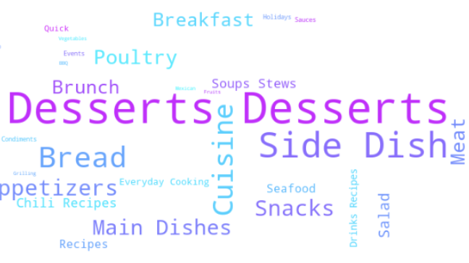
Dashboard demo

Slide 9
Thank you!

